Slide 1

EZTechMovie Streaming Platform
University of Arizona Global Campus
INT499: Capstone for Information Technology
Professor John Russell
May 26, 2025
Kolton Tarango, Avery Krouskop, Erin Weathers, and Manuel Ochoa
Notes:
Good afternoon, my name is Kolton Tarango and I will be presenting my team’s EZTechMovie Streaming Platform for our week 2 assignment.

Slide 2
EZTechMovie Streaming Platform
Project Goal: Build a subscription-based movie streaming interface.
Key Features:
- User authentication (Sign Up / Login)
- Movie browsing and search
- Add/remove movies to cart
- Secure subscription and checkout
- Role-based routing and Google OAuth
Notes:
Welcome to the EZTechMovie project overview. Our goal is to create a functional, user-friendly movie streaming web application. Users will be able to sign up, log in, search and browse movies, and subscribe through a secure checkout process. Our design includes a cart system, Google OAuth login, and a clear navigational structure.

Slide 3
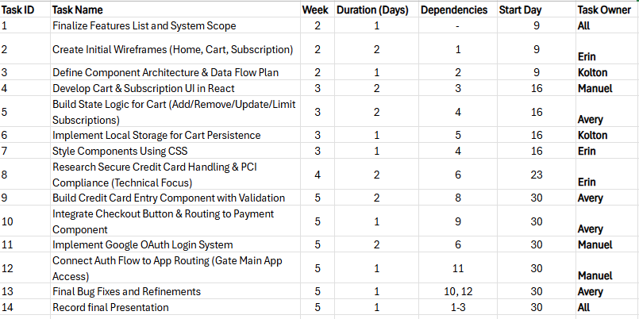
Project Timeline and Tasks
14 Tasks across 5 weeks
Tasks include planning, UI design, backend logic, and deployment
Tasks assigned to Erin, Kolton, Manuel, and Avery
Notes:
This table provides an overview of the draft Gantt chart we developed as a planning tool. Each of the 14 tasks is listed along with the day it starts, duration in days, and the team member assigned. Tasks were aligned with individual strengths—for instance, Kolton leads on routing, while Erin is responsible for UI components. This chart helped ensure an even workload and a logical sequence of steps

Slide 4
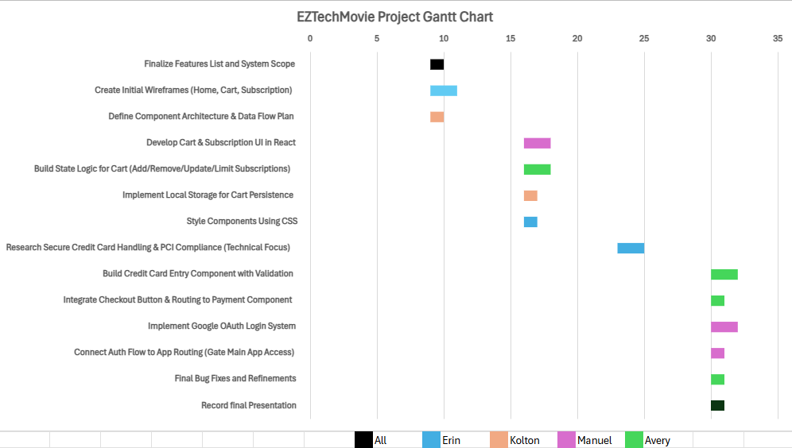
Visual Gantt Chart Layout
Notes:
Here is the full Gantt chart visualization. It displays our project schedule from start to finish, with tasks plotted along a time axis. It highlights dependencies—for example, we cannot begin implementation until the wireframe is approved. It also shows which tasks can run concurrently, improving efficiency. This visual tool has been essential in tracking our workflow and ensuring nothing gets missed.

Slide 5

Week 5 Key Deliverables
Final Implementation: OAuth, routing, credit card entry, checkout
Testing and bug fixes
Final presentation recording
Notes:
Week 5 is the most intensive phase of our project. It includes major deliverables such as implementing the Google Open Authorization login, routing logic for authenticated users, and integrating the checkout button. This week also covers final testing, bug fixes, and recording our final presentation. All tasks are coordinated to meet the project deadline.

Slide 6
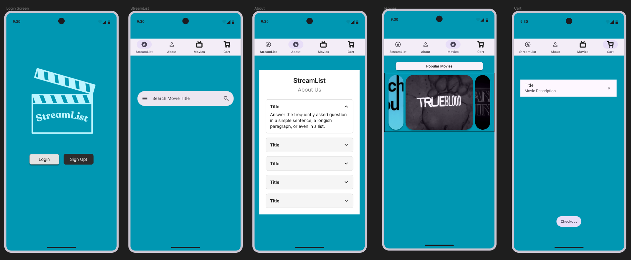
Interface Design Outline
Login/Sign-Up Page
Home page with navbar: StreamList | About | Movies | Cart
Movie detail view with title and description
Checkout page
Notes:
This wireframe illustrates our initial UI structure. The app includes a top navigation bar for seamless access to StreamList, About, Movies, and Cart pages. Users begin at the Login or Sign-Up screen. Once authenticated, they can browse movies, view descriptions, and access a dedicated checkout page.

Slide 7
User Journey
Simple, mobile-friendly layout
Clear navigation from login to checkout
Focus on usability and accessibility
Notes:
The navigation design ensures users can easily move through the app—from logging in to managing their cart and completing checkout. We kept the layout mobile-friendly, avoiding visual clutter and supporting accessibility. This structure supports a smooth, intuitive user experience.

Slide 8
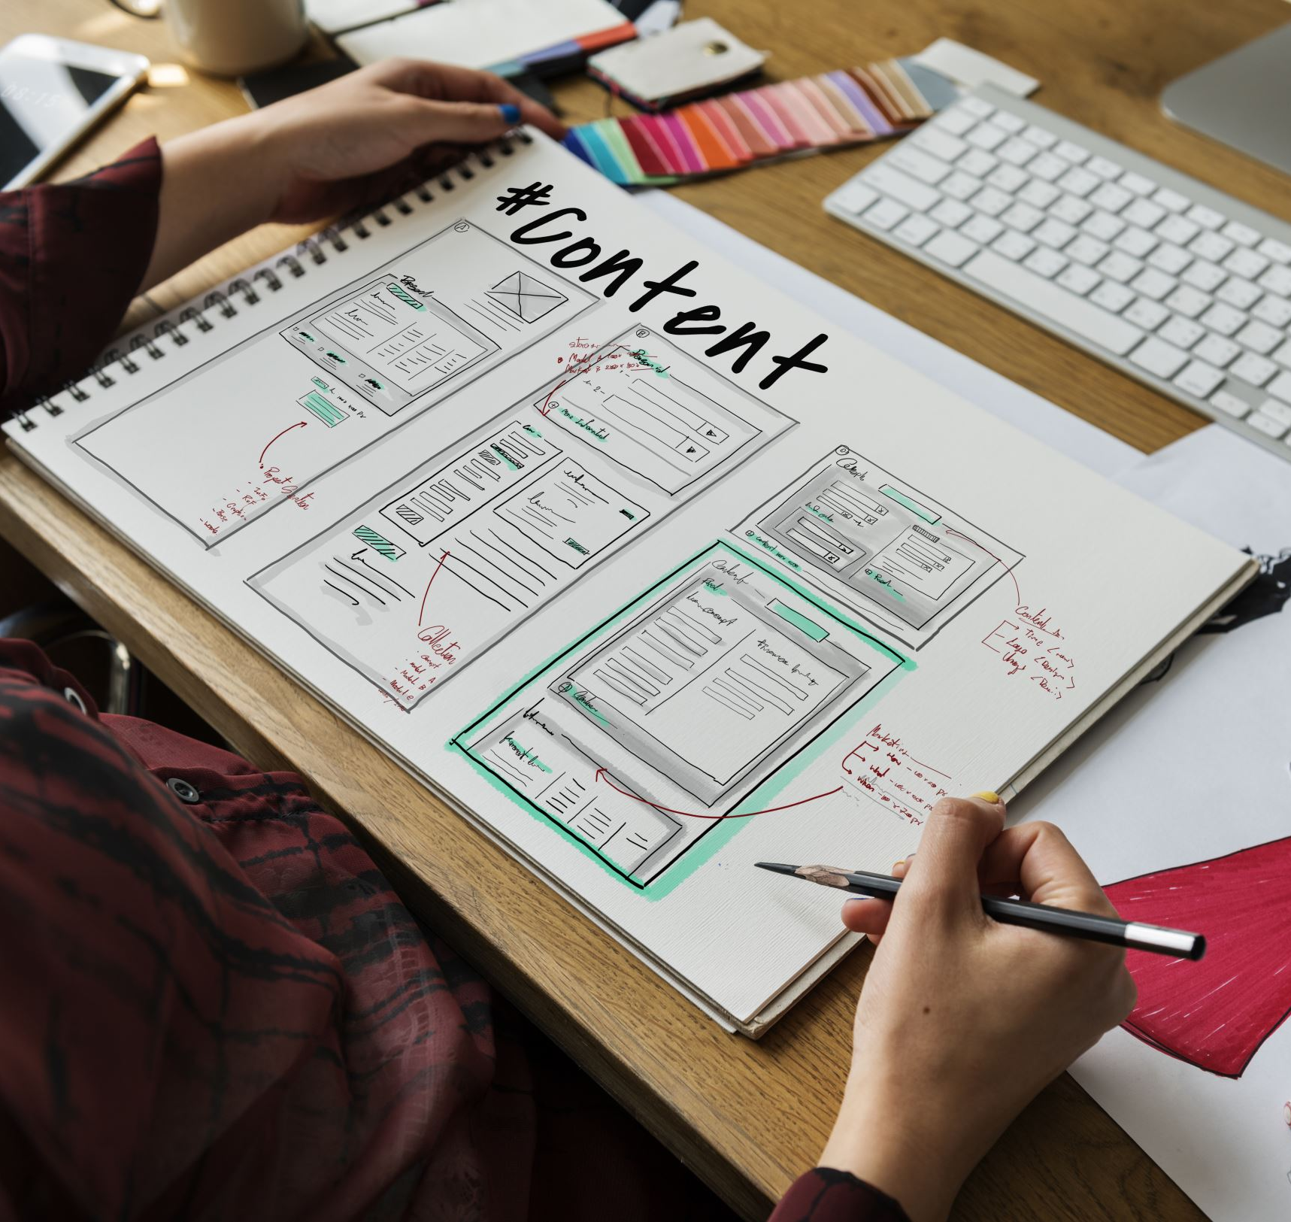
Wrapping Up Content
Strong planning with Gantt chart and task allocation
Clear, user-focused interface design
On track for successful and timely project delivery
Notes:
To conclude, our project combines detailed planning, a strong team structure, and a user-friendly design approach. The Gantt chart has helped us organize and pace our development efforts effectively, while our wireframe guides our UI with clarity and intent. We're confident in our timeline and committed to delivering a polished final product.

